Slide 1
JavaScript Unit Testing: Jasmine, Mocha, Istanbul, TDD, BDD. Part1
by Yurii Holskyi

Slide 2

Importance of Unit testing?
Before we get into understanding the available tools and their benefits, let us understand why unit testing is important.
Unit testing is the process of testing the implemented code at a module level. Unit testing allows you to ensure that your developed modules are meeting the requirements specified by the business document. These tests are written for every module as they are created. After every new module development, the entire suite of test cases is run to ensure that no existing modules are affected by the developed module.

Slide 3

MochaJS
MochaJS is the most popular testing framework that supports backend and frontend testing. MochaJS is a flexible base for developing tests as you need. It runs the tests asynchronously on Chrome v8 engine or any other browser.

Slide 4
MochaJS
The major benefits of Mocha include:
1) Works for frontend as well as backend;
2) Support NodeJS debugger;
3) Provides a clean base to develop tests as per the developer’s convenience;
4) Supports any browser including headless chrome library;
5) Supports object mocking to perform flexible backend tests.
To install mocha into your project command:
npm i mocha –D or yarn add –D mocha

Slide 5
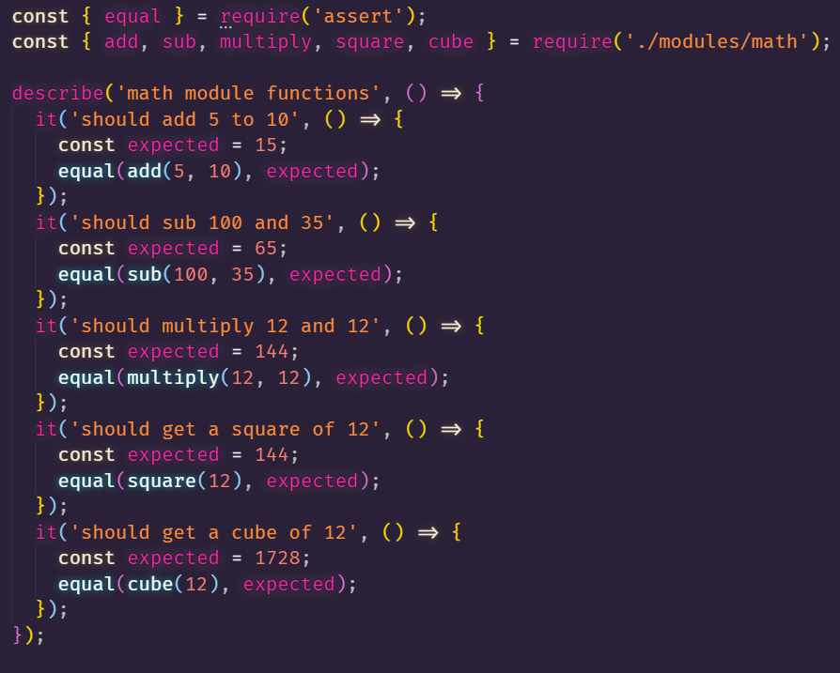
MochaJS example

Slide 6

Jasmine
Jasmine is a user-behavior mimicker that allows you to perform test cases similar to user behavior on your website. Jasmine is useful for a testing frontend for visibility, click clarity as well as the responsiveness of the UI in different resolutions. Jasmine allows to automate user behavior with customs delays and wait time to simulate actual user behavior.

Slide 7
Jasmine
The major benefits of using Jasmine include:
1) Lower overhead due to almost zero external dependencies;
2) Comes with almost every required tool out of the box;
3) Supports Frontend as well as Backend tests;
4) The coding is pretty similar to writing in natural language;
5) Extensive documentation to use it with several frameworks.
To install jasmine:
npm i jasmine-node –D or yarn add jasmine-node -D

Slide 8
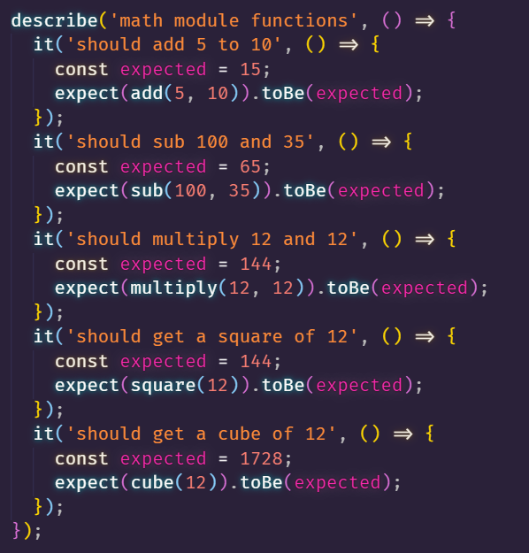
Jasmine example

Slide 9

Istanbul
JavaScript test coverage made simple.
Istanbul instruments your ES5 and ES2015+ JavaScript code with line counters, so that you can track how well your unit-tests exercise your codebase.
Support for the most popular JavaScript testing frameworks (see our tutorials).
Support for instrumenting subprocesses, using the nyc command-line-interface.

Slide 10
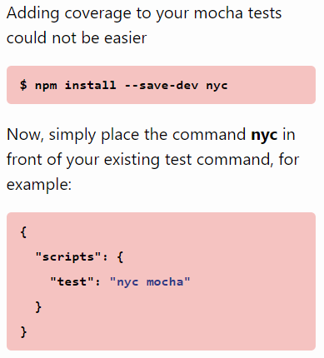
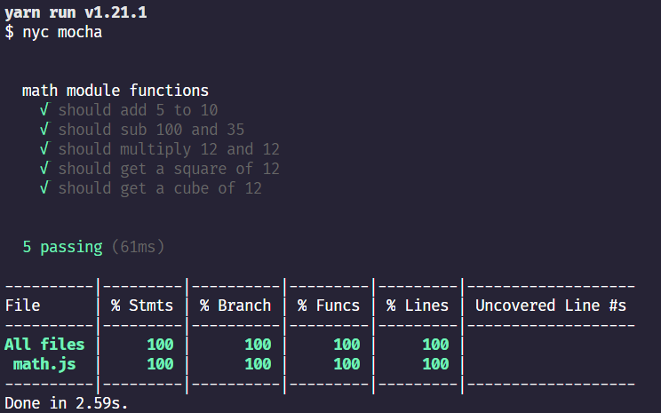
Istanbul example

Slide 11
TDD
Test-driven development (TDD) is an approach to development that consists of writing tests, followed by production code, and refactoring as needed. The tests are written to fail initially, and the developer writes code to fulfill the requirements of the test so they pass.
1) Start by writing a test;
2) Run the test and any other tests. At this point, your newly added test should fail. If it doesn’t fail here, it might not be testing the right thing and thus has a bug in it;
3) Write the minimum amount of code required to make the test pass;
4) Run the tests to check the new test passes;
5) Optionally refactor your code;
6) Repeat from 1.

Slide 12
BDD
BDD – Behavior-Driven Development.
One of the key things BDD addresses is implementation detail in unit tests. A common problem with poor unit tests is they rely too much on how the tested function is implemented. This means if you update the function, even without changing the inputs and outputs, you must also update the test. This is a problem.
BDD addresses this problem by showing you how to test. You should not test implementation, but instead behavior. Let me show you an example of what happens when you think of implementation, and when you think of behavior.

Slide 13
Conclusion from TDD and BDD
TDD: write test => watch it fail => implement => watch it pass => refactor => repeat;
BDD: initialize state => change state => verify new state.

Slide 14
Thank You.

